Slide 2
Lecture 1:
Why Parallelism?
Parallel and Distributed Computing
Rutgers ECE 451-566, Fall 2021
Maria Striki

Slide 3
One common definition
A parallel computer is a collection of processing elements that cooperate to solve problems quickly
We care about performance
We care about efficiency
We will use multiple processors to get it

Slide 4
Speedup
One major motivation of using parallel processing: achieve a speedup
For a given problem:

Slide 5
DEMO 1
Adding up 12 numbers
How Fast?
Simplest Solutions?
Efficiency?
Notes:
STEP 1: Time one student (12 numbers)
There’s fundamental limit to how fast he/she is going to be able to do this
Q. HOW CAN WE MAKE IT FASTER
STEP 2: Bring in a second student, but don’t let them talk (6 numbers each)
Q. WHAT WAS THE TIME?
STEP 3: Let them shout.

Slide 6
Class observations from demo 1
Communication limited the maximum speedup achieved
In the demo, communication included the interchange of partial sums.
Minimizing the cost of communication improved speedup
Moved “processors” closer together: how?

Slide 7
DEMO 2
Scaling up to 4 processors:
Adding up 12 numbers
How Fast?
Simplest Solutions?
Efficiency?
Notes:
uneven distribution of work to students: A, B, C, D
Improve by work stealing
or putting piles on the table

Slide 8
Class observations from demo 2
Imbalance in work assignment limited speed up
Some students (“processors”) ran out work to do (went idle), while others were still working on their assigned task
Improving the distribution of work improved speedup

Slide 9
DEMO 3
Massively Parallel Execution
Adding up X numbers
How Fast?
Simplest Solutions?
Efficiency?
Can we do better?

Slide 10
Class observations from demo 3
This problem has a significant amount of communication compared to computation
Communication costs can dominate a parallel computation, severely limiting speedup

Slide 11
Course theme 1:
Designing and writing parallel programs ... that scale!
Parallel thinking
Decomposing work into parallel pieces
Assigning work to processors
Orchestrating communication/synchronization between the processors so that it does not limit speedup
Abstractions for performing the above tasks
Writing code in popular parallel programming languages

Slide 12
Course theme 2:
Parallel computer hardware implementation: how parallel computers work
Mechanisms used to implement abstractions efficiently
Performance characteristics of implementations
Design trade-offs: performance vs. convenience vs. cost
Why do I need to know about Hardware
Because the characteristics of the machine really matter
(recall speed of communication issues in class demos)
Because you care about efficiency and performance
(you are writing parallel programs after all)

Slide 13
Course theme 3:
Thinking about efficiency
FAST != EFFICIENT
Just because your program runs faster on a parallel computer, it does not mean it is using the hardware efficiently
Is 2x speedup on 10 processors a good result?
Programmer’s perspective: make use of provided machine capabilities
Hardware designer’s perspective: choosing the right capabilities to put in system (performance/cost, cost = silicon area?, power?, etc.)

Slide 14
Why parallelism?

Slide 15
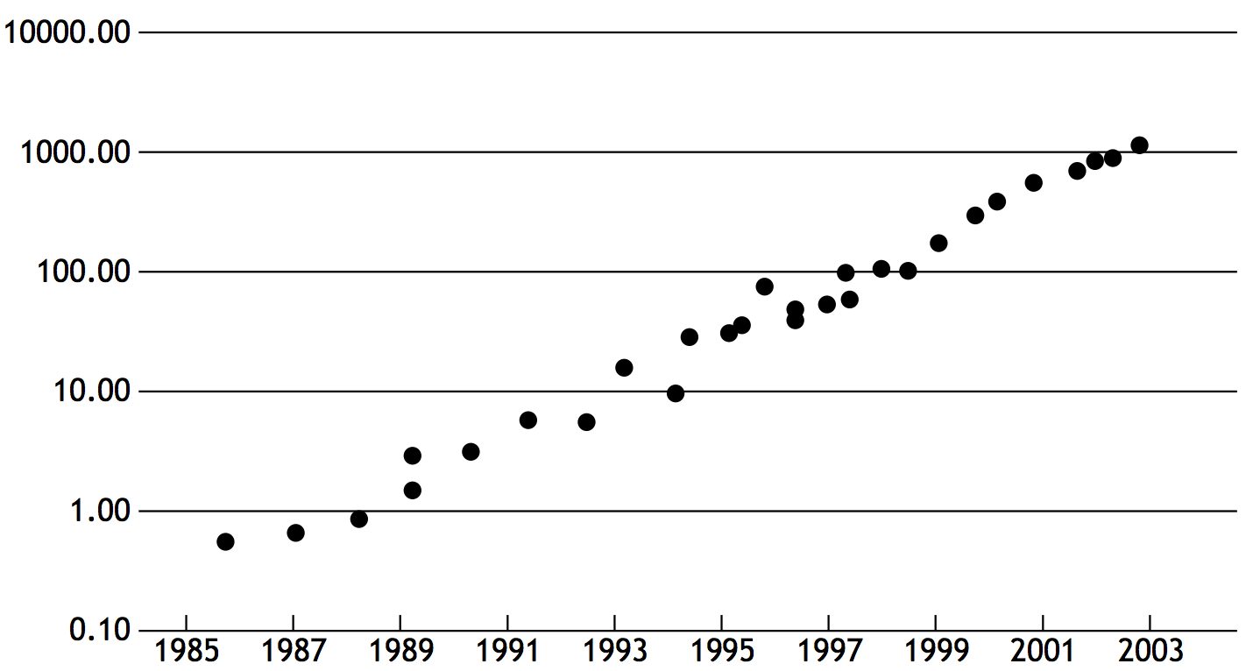
Why parallel processing?
The answer 10-15 years ago
To realize performance improvements that exceeded what CPU performance improvements could provide
Because if you just waited until next year, your application would run faster on a new CPU
Implication: working to parallelize your code was often not worth the time
Software developer does nothing: CPU performance doubles ~ every 18 months.
Relative CPU Performance
YEAR
Year
Notes:
this is log scale, so it’s exponentially increasing
10x every four years, more than 3 doublings

Slide 16
Until 10 years ago:
two significant reasons for processor performance improvement
1. Increasing clock frequency
2. Exploiting instruction level parallelism (superscalar execution)

Slide 17
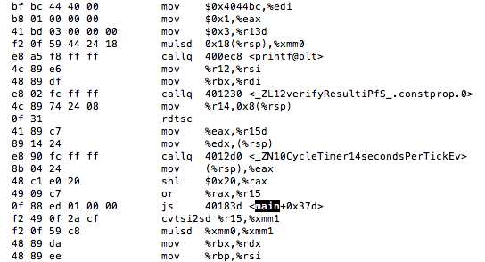
Instruction level parallelism (ILP)
Processors did in fact leverage parallel execution to make programs run faster, it was just invisible to the programmer
Instruction level parallelism (ILP)
Idea: Instructions are meant to be executed in program order. BUT independent instructions can be executed simultaneously by a processor without changing program correctness
Superscalar execution: processor detects independent instructions in an instruction sequence and executes them in parallel

Slide 18
ILP example
a = (x*x + y*y + z*z)
x
x
y
y
z
z
ILP = 3
*
*
*
ILP = 1
+
ILP = 1
+
a

Slide 19
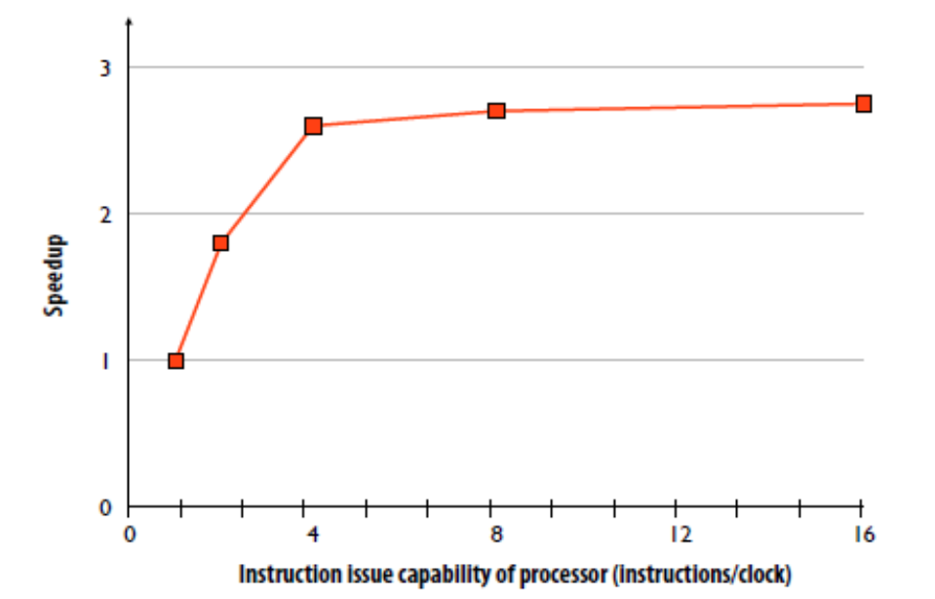
Diminishing returns of superscalar execution
Most available ILP exploited by processor capable of issuing four instructions per clock.

Slide 20
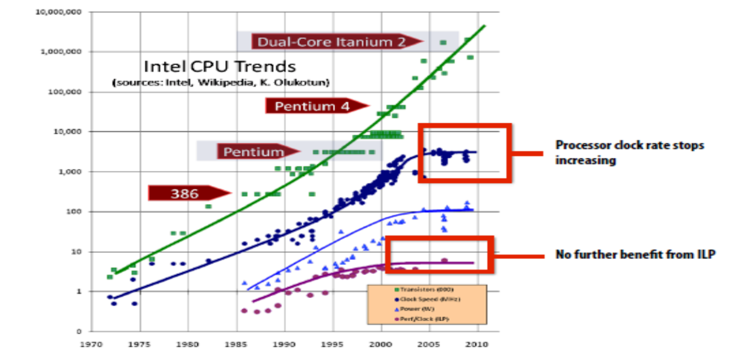
ILP tapped out + end of frequency scaling
Image Credit: “The free Lunch is Over”, Herb Sutter, Dr Dobbs, 2005

Slide 21
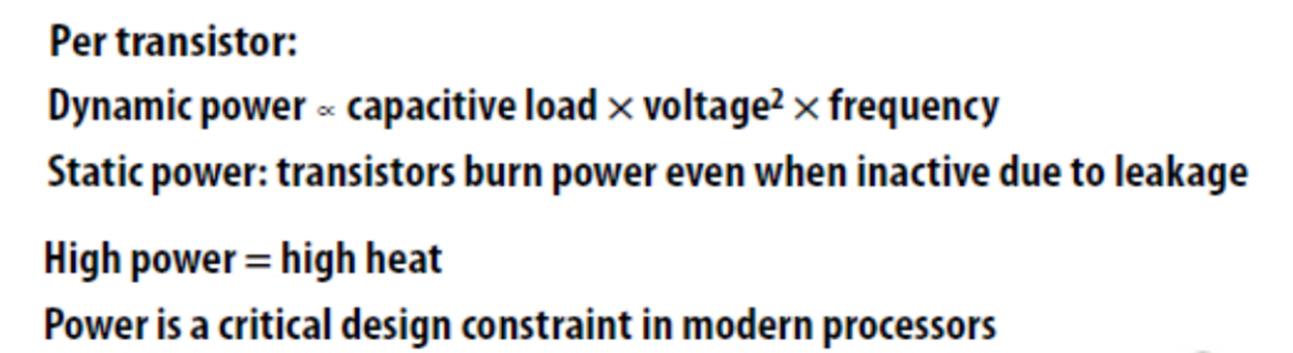
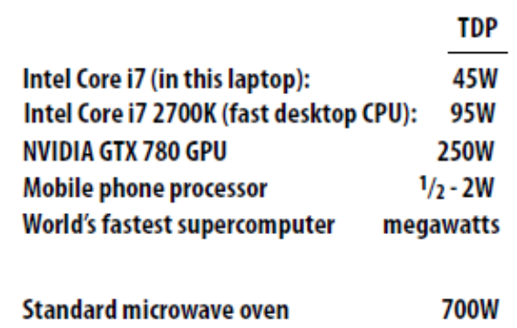
The “power wall”
Source: Intel, NVIDIA, Wikipedia, Top500.org

Slide 22
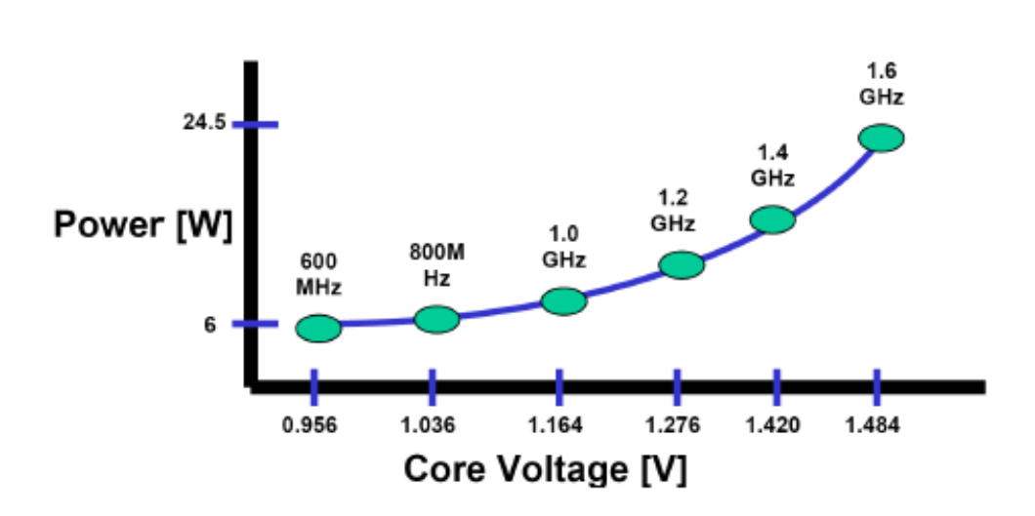
Core voltage increases with frequency
Pentium M CPU
Image Credit: Intel

Slide 23
CPU Power (and the “Power Wall”)
We know that P=V x I (watts)
The CPU voltage V is the DC voltage supplied to the CPU.
The amount of power a CPU uses, and thus the amount of heat it dissipates, is the product of the voltage applied to the CPU and the current it draws.

Slide 24
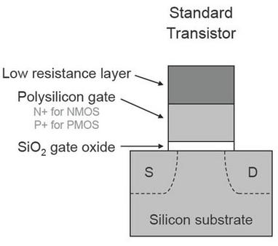
CPU Power
In modern CPUs made using CMOS technology, the current is almost proportional to the clock speed
CPU drawing almost no current between clock ticks.
Almost because there
still are leakage currents

Slide 25
CPU Power - the Heat Issue
We know that CPU clock frequency increase reduces CPU time thus improves performance
So let’s make clocks even faster …
BUT Power consumption and power loss are correlated with the clock frequency because:
Dynamic power (consumed during switching) = V(t) x I(t):
V(t) x (C x dV/dt on a capacitor) =
V(t) x (C x (V(T)-0)/T_{clock_period})) =
V(t) x (C x V(t) x Clock_Freq) =
Voltage² × Capacitive load × Clock frequency

Slide 26
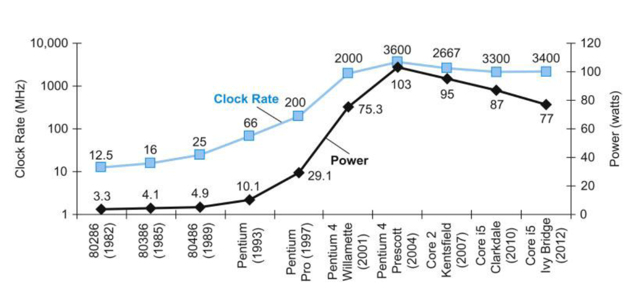
Why the clock frequency plateau?
Single core
Multi core
5V → 1V
×1000

Slide 27
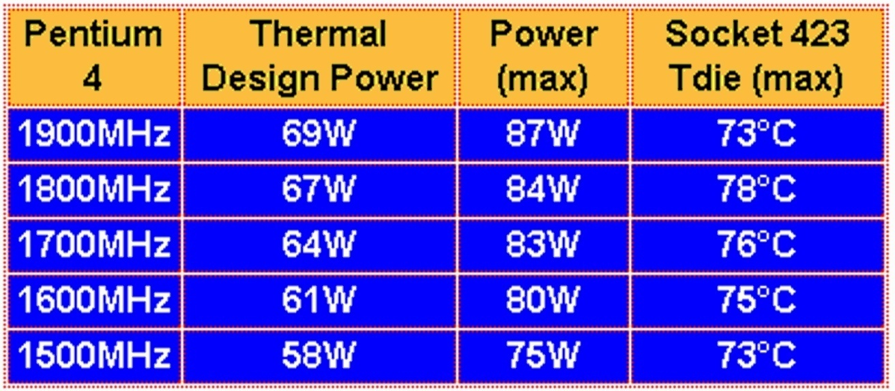
CPU Power- continued
The energy consumption of single-core CPUs
70 - 100 W – is the power of a light bulb).
So the CPU generates lots of heat
Heat makes CPU gates less stable – can lead to errors

Slide 28
What can be done to reduce heat generation?
Heat removal
Voltage lowering (has its own perils)
Reduction in leakage current
Architectural changes (change the way the CPU is designed) so to reduce clock speed without reducing performance (most potential for improvement)

Slide 29
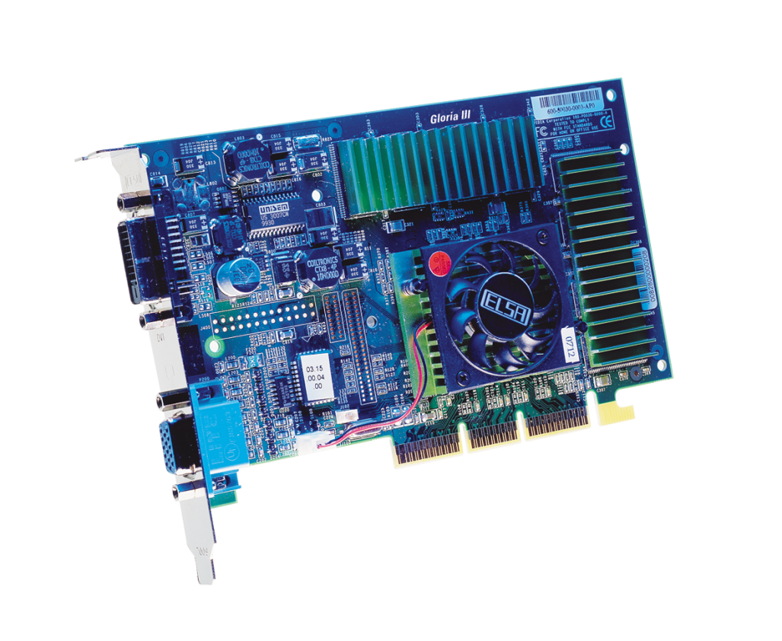
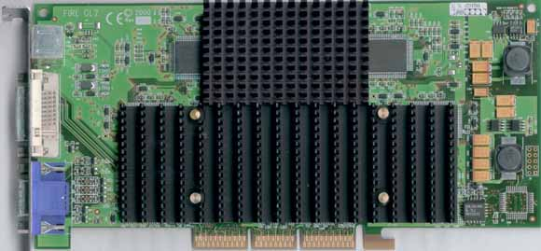
Heat removal
Heat needs to be dissipated somehow to cool down the CPU to reduce errors!
Active cooling
Passive cooling (old solution)

Slide 30
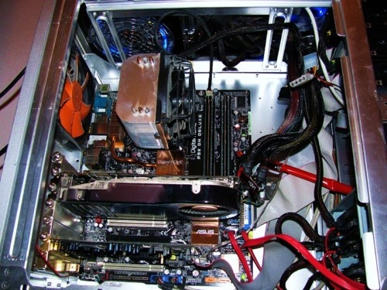
Heat removal - continued
Measures to remove (wasted energy) heat have limits
Fan
Fan
Fan
Fan

Slide 31
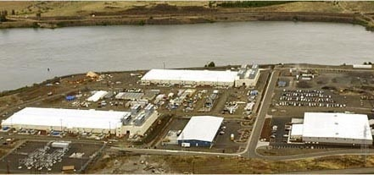
Heat Removal- continued
Now multiply this with a million computers, such as Google server farms…
Organized in container parks. Each shipping container can hold up to 1,160 servers, and uses 250 kilowatts of power, giving the container a power density of more than 780 watts per square foot
Heat goes in the river

Slide 32
Voltage Reduction
Dynamic power = Capacitive load×Voltage² × Clock frequency
Reduce voltage - Voltage went from 5 V down to 1 V today
Lowering the voltage further increases static power losses due to leakage – when transistors are “off” – more transistors, more leakage (static power).

Slide 33
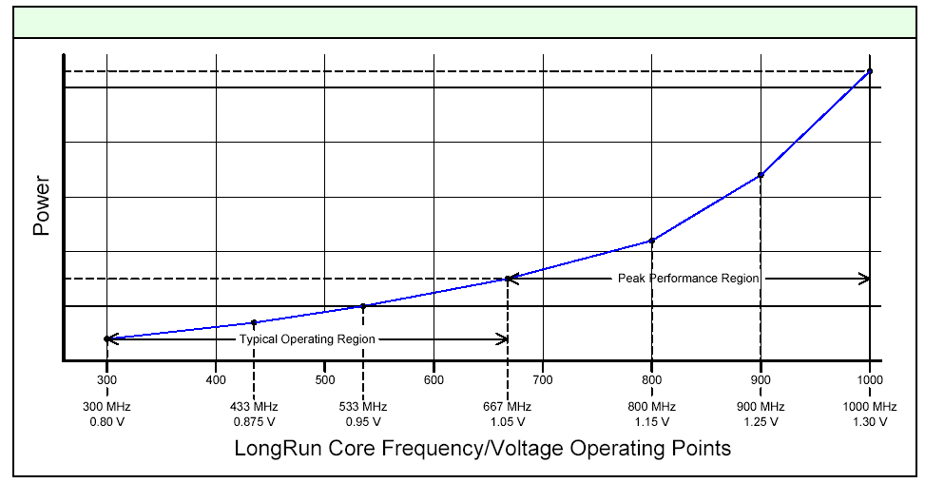
Benchmarks and Energy efficiency
Reducing power means reducing voltage and/or reducing clock frequency – a technique used in laptops and other mobile applications;
Processors then have three modes: max clock, adaptive clock, min clock (min power).

Slide 34
Low Voltage Effect On CPU Accuracy
Not all transistors work
Unstable system
Increase error rate
Keep retrieving data from input.
Lower computer speed.

Slide 35
Architectural Changes – Multi-core
Multi-core is different from multi-CPU
(in the bad old days) Multi-CPU meant several CPUs on the same motherboard.
Multi-CPUs with 1 core each had lower performance than 1 multi-core CPU due to slow busses
Single-core CPU had less execution parallelism
Making 2 CPUs instead of single 2-core one more expensive
Multi-core improves performance by parallelization of application execution of several cores (at lower clock speed). BUT – programmers need to re-write apps for multi-core processing – not easy!

Slide 36
Single-core performance scaling
The rate of single-instruction stream performance scaling has decreased (essentially to 0)
1. Frequency scaling limited by power
2. ILP scaling tapped out
Architects are now building faster processors by adding processing cores
Software must be written to be parallel to see performance gains. No more free lunch for software developers!
Image credit: Herb Sutter

Slide 37
Why parallelism?
The answer 10 years ago
To realize performance improvements that exceeded what CPU performance improvements could provide
(specifically, in the early 2000‘s, what clock frequency scaling could provide)
Because if you just waited until next year, your code would run faster on the next generation CPU
The answer today:
Because it is the only way to achieve significantly higher application performance for the foreseeable future *

Slide 38
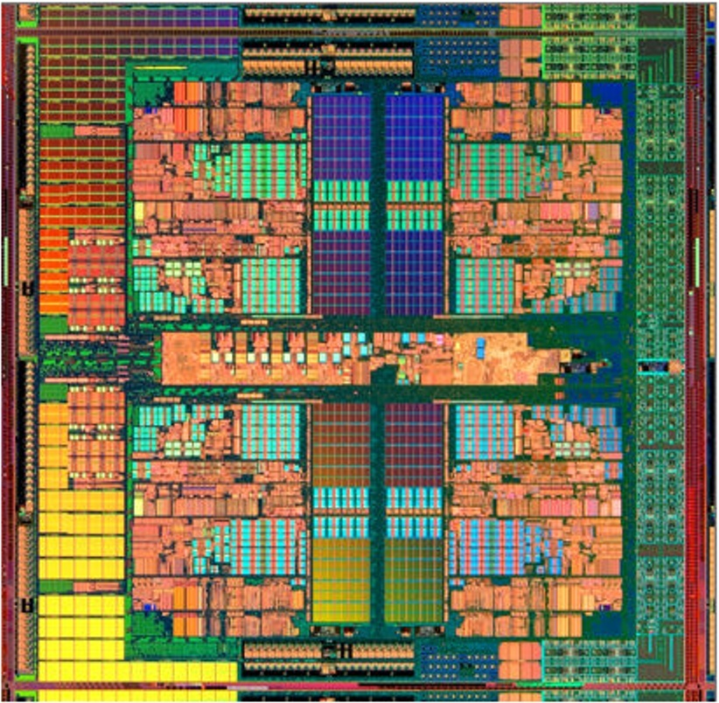
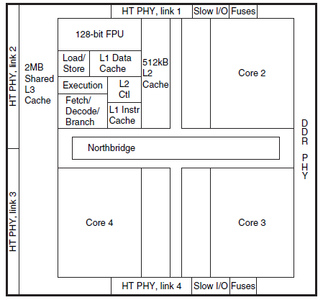
AMD Barcelona multi-core chip
Cache memory uses Static RAM (SRAM), faster but less dense and more expensive that Dynamic RAM (DRAM)
Each core has Level 1 and Level 2 cache, while L3 is shared

Slide 39
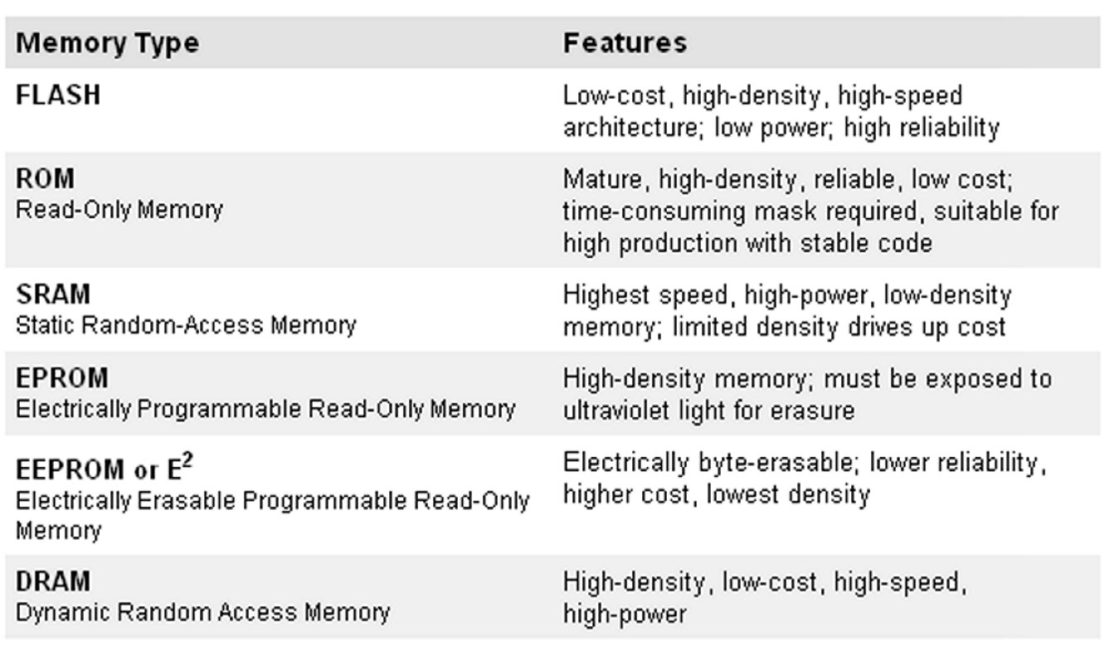
Solid-state Memory types
Volatile (DRAM – Dynamic Random Access Memory)
Non-volatile – like EPROM, FLASH, DVD.
Cache
Main Memory

Slide 40
Core 1 Core 2 Core 3 Core 4
Register
L1 Cache
L2 Cache
L3 Cache
DRAM
Hard Disk

Slide 41
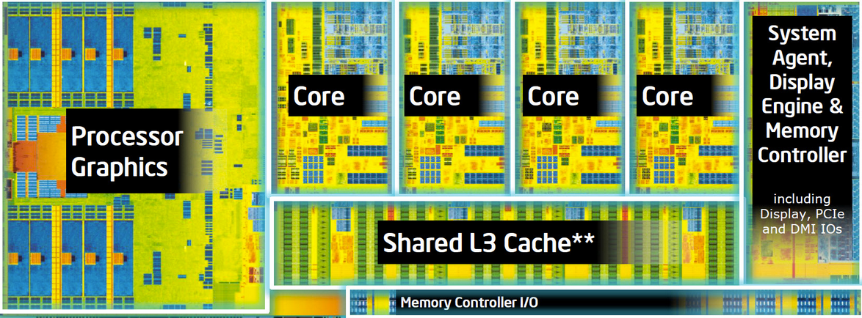
Intel Haswell (2013)
Quad-core CPU + multi-core GPU integrated on one chip

Slide 42
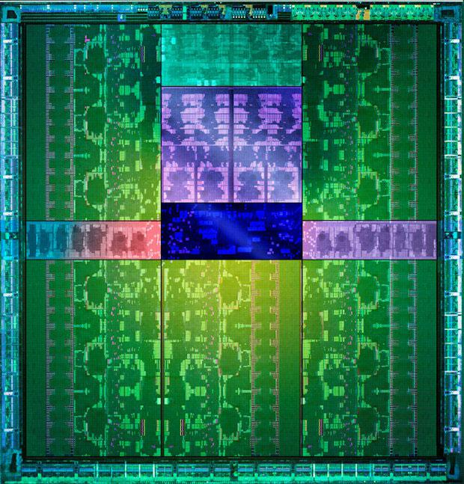
NVIDIA Kepler GTX 780 GPU (2013)
Twelve major processing blocks
(but much more parallelism to use...)

Slide 43
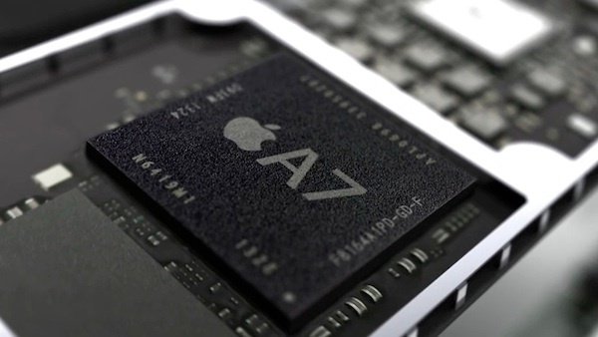
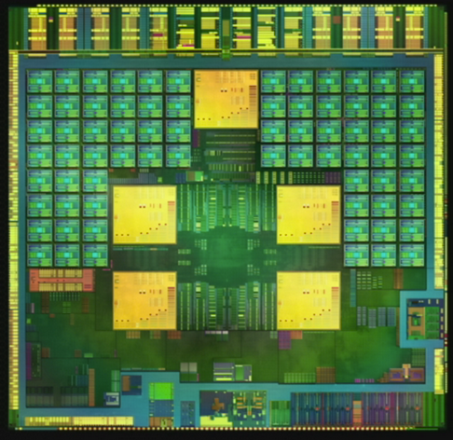
Mobile parallel processing
Power constraints heavily influence design of mobile systems
Apple A7: (in iPhone 5s and modern iPad)
Dual-core CPU + GPU + image processor and more on one chip
NVIDIA Tegra 4:
Quad core CPU + GPU + image processor...

Slide 44
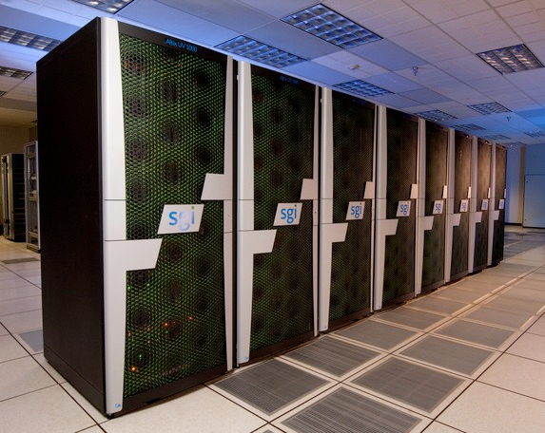
Supercomputing
Today: clusters of CPUs + GPUs
No 1: World’s Fastest Supercomputing Center: “Fugaku” in Kobe, Japan, June 22, 2020
Fujitsu 48-cores, Performance: 415 PetaFlops in specific high-performance machine, outperformed second fastest by 2.8x.
No 2: “Summit” in Tennessee, US, Oak Ridge National Laboratory (ORNL), 2018
IBM-built, Perf: 148 PetaFlops in HPM,
4,356 nodes, each with two 22-core Power9 CPUs, and six NVIDIA Tesla V100 GPUs. The nodes are connected with a Mellanox dual-rail EDR InfiniBand network.
No 3: “Sierra” in Livermore, California, US, 2018
IBM-built, Perf: 94 PetaFlops in HPM,
Nodes: each with 2 CPUs and 4 GPUs,. The nodes are connected with EDR InfiniBand network.
No 4: “SunWay TaihuLight”, Jiangsu, China, Nov. 2016
IBM-built, Perf: 93 PetaFlops in HPM,
Nodes: each with 256 CPUs.

Slide 45
Summary
Single-thread of control performance scaling has ended
To run faster, you will need to use multiple processing elements
The implication of this development is that you need to know how to write parallel code
Writing parallel programs can be challenging
Problem partitioning, communication, synchronization
Knowledge of machine characteristics is important

